Slide 1
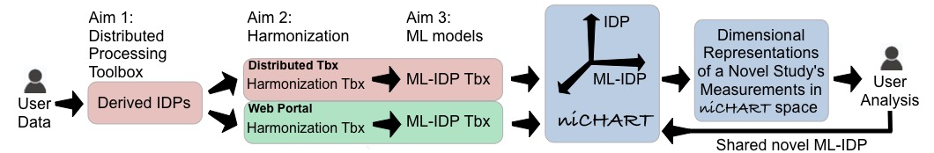
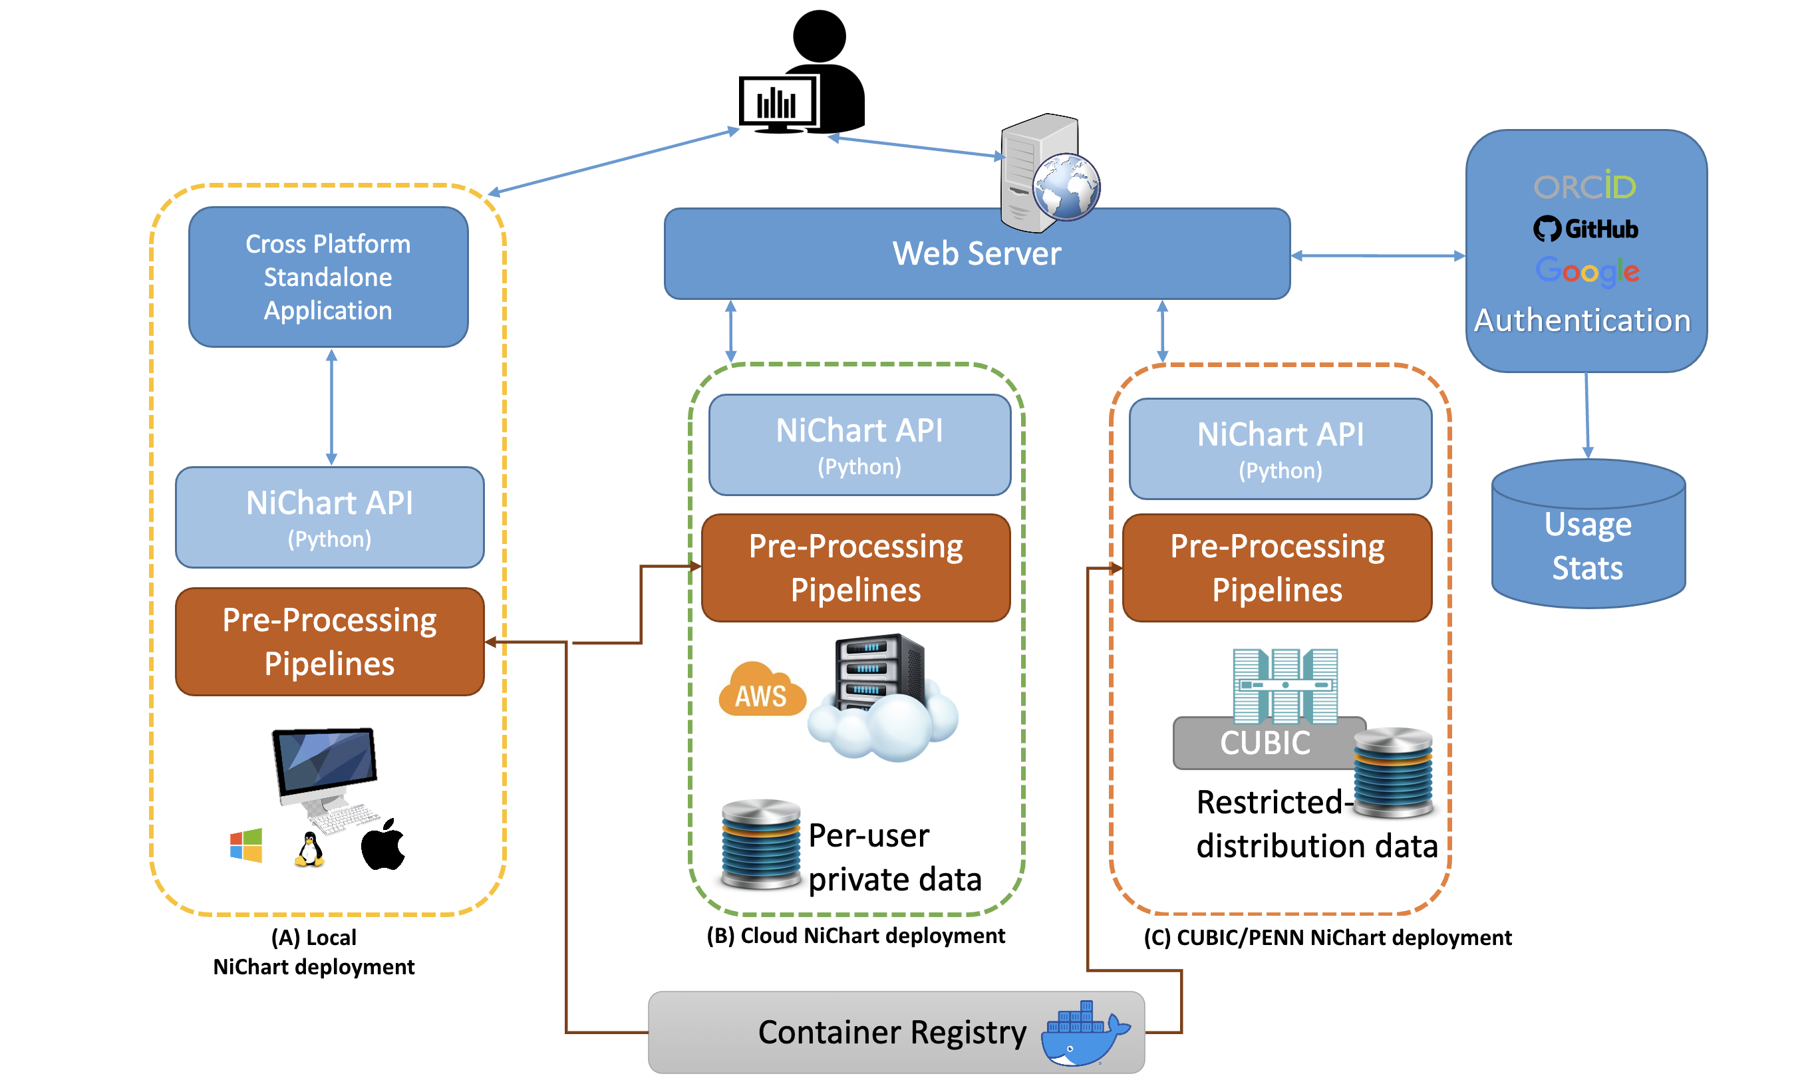
HPC
HPC NiChart deployment
Fig 1a. Schematic of NiChart software suite. Modality-specific image processing toolboxes are used to calculate imaging derived phenotypes. After statistical data harmonization of derived values, models pre-trained on large reference datasets are applied to calculate machine learning based imaging phenotypes of various diseases and conditions, allowing to position the individual into the neuroimaging chart, a multi-dimensional quantitative coordinate system of brain health.
Fig 1b. The users can utilize the NiChart framework in a variety of ways, either through a local installation, through the publicly available web server, or through a private web server on their High Performance Cluster (HPC), if available.

Slide 2
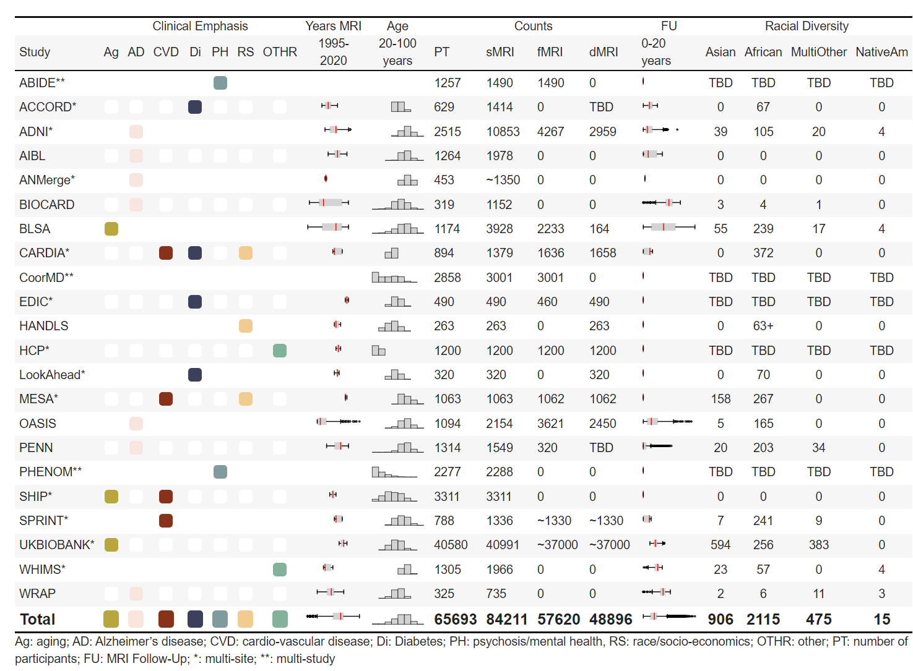
Fig 2. Reference MRI dataset used for data harmonization and for training machine learning (ML) models

Slide 3
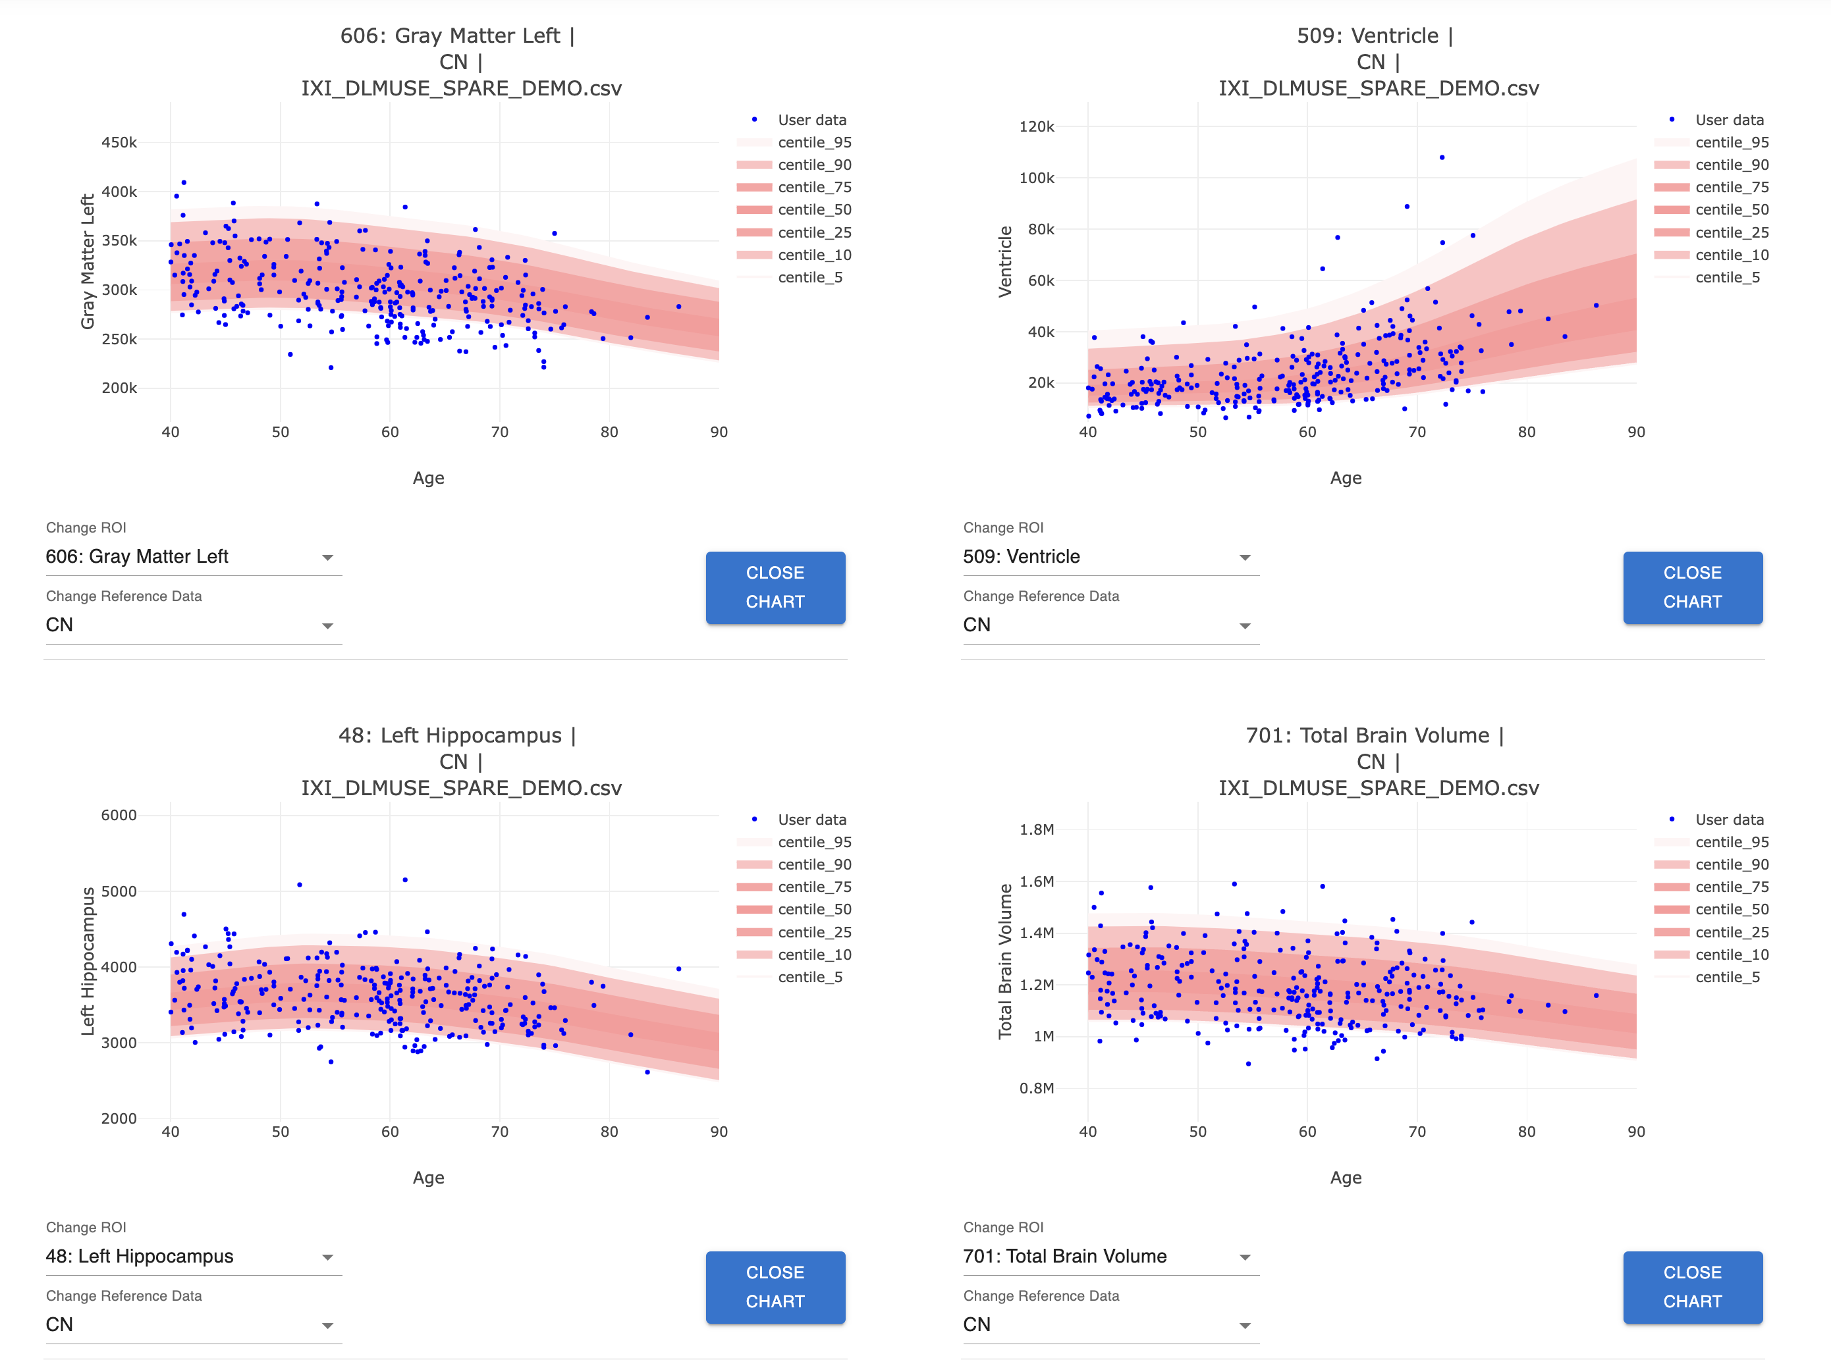
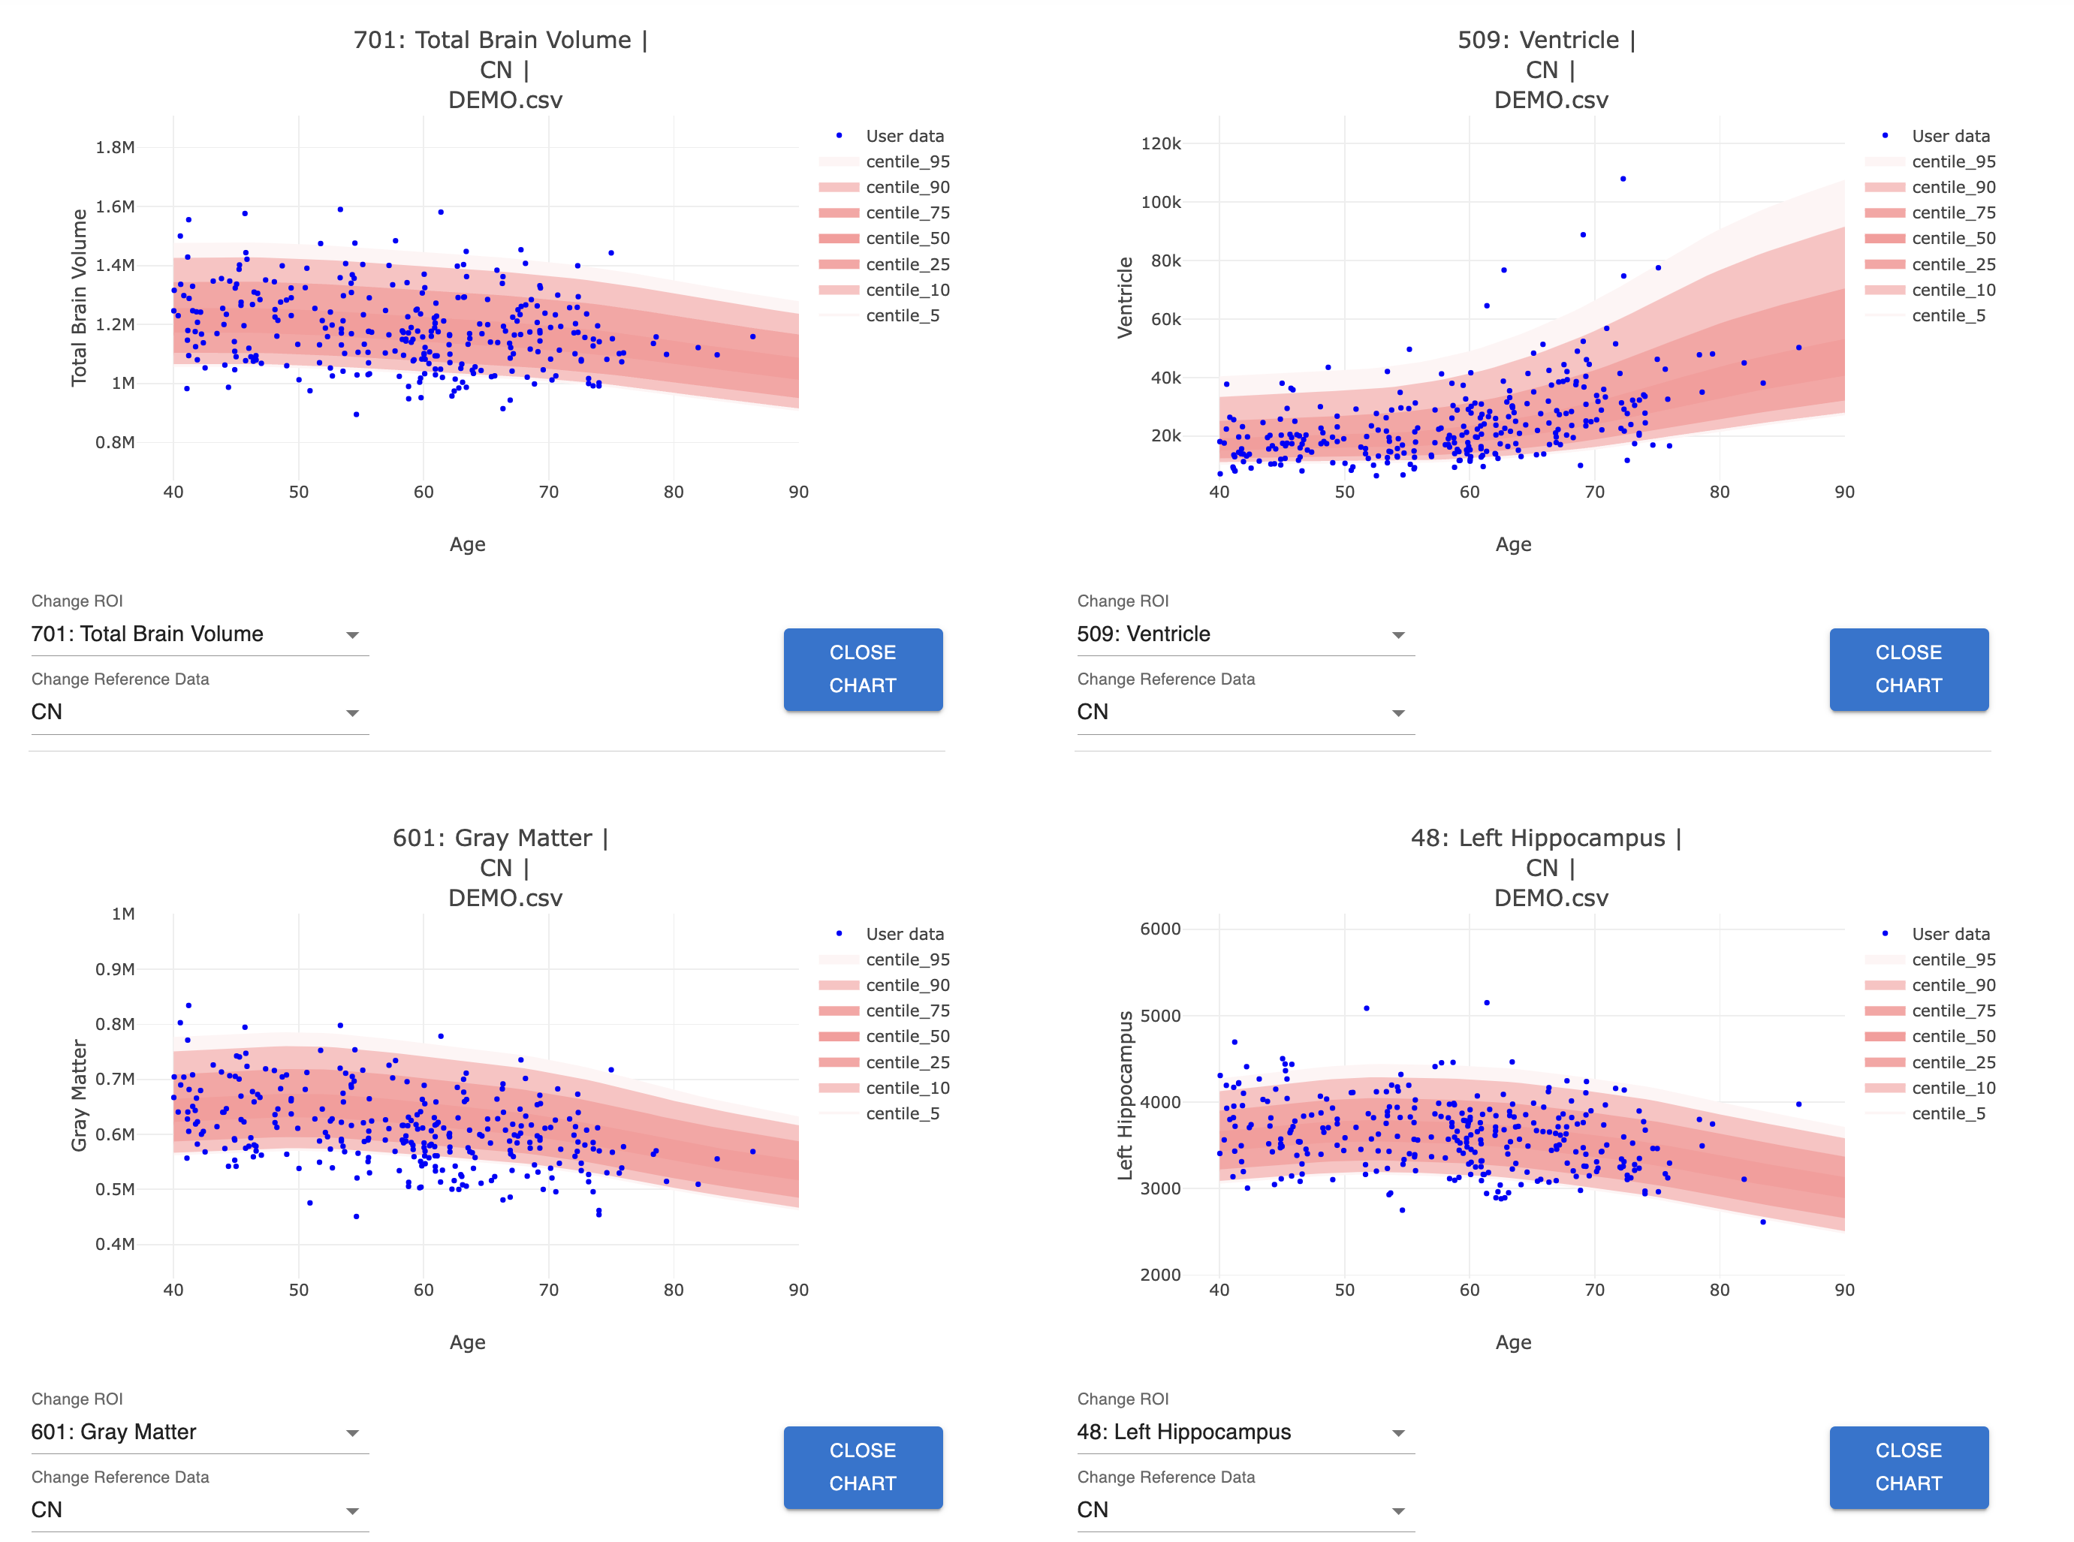
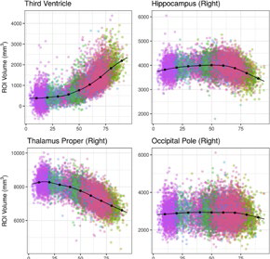
Fig 3. Age trends of selected imaging derived phenotypes after data harmonization (as viewed on the NiChart web portal, using a simulated dataset).

Slide 4
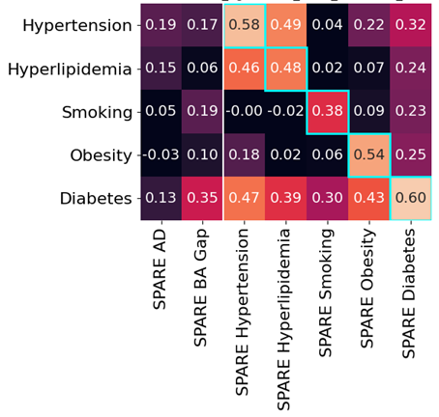
Fig 4. Panel of machine learning based imaging phenotypes (in this case SPARE scores) derived from the reference dataset. Correlations between SPARE scores for various diseases and conditions

Slide 5
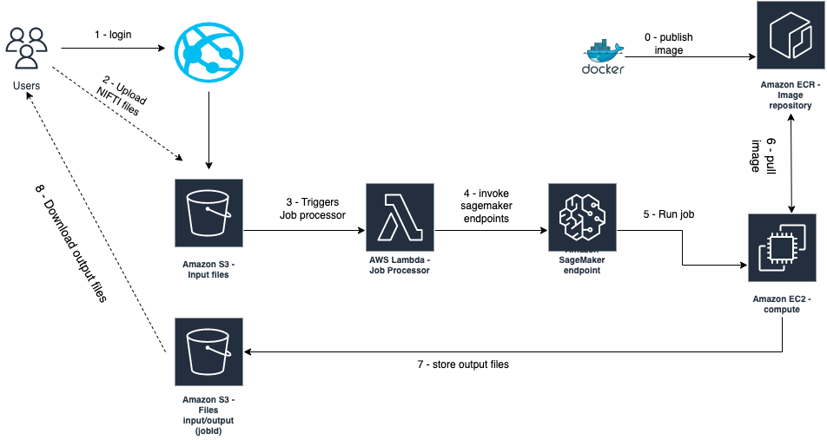
Fig 5. Architecture diagram of the web interface backend

